Slide 1
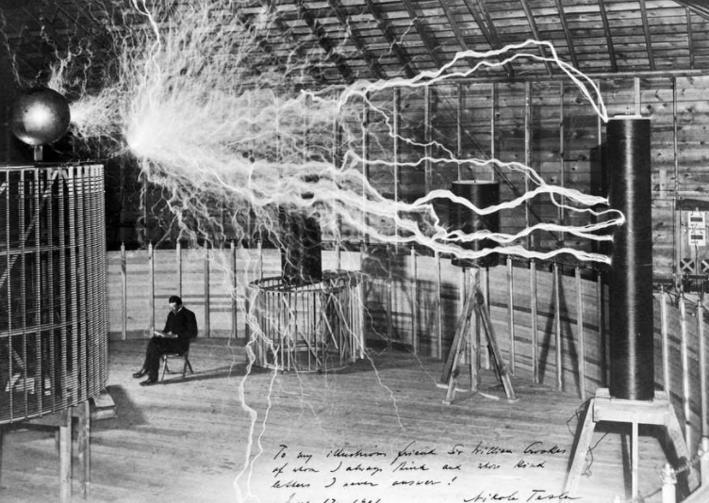

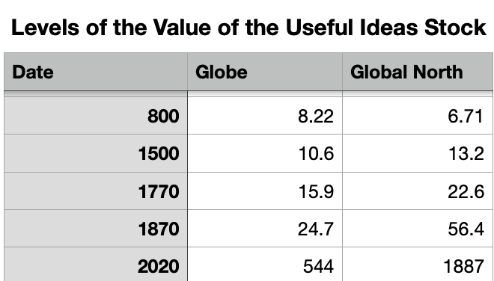
Lecture: Revving Up the Engine of Growth: 1870-1914
Growth rates of ideas stock:
800 to 1500 to 1770 to 1870 to 2020
Globe per year: 0.035%, 0.15%, 0.44%, 2.06%
Global North: 0.096% (catchup), 0.20%, 0.91% (industrialization), 2.34% (divergence)
Before 1870, this growth simply not fast enough to outrun fecundity and create a society rich enough to trigger the demographic transition
After 1870, it was…
Causes:
Principal cause: The modern corporation and its industrial research labs that made routine the process of developing and then implementing new productive ideas
Secondary cause: globalization: of goods, of people, of communications
6:30 of audio in this slide; 21:15 in this slide group
Notes:
Recapitulate: the growth rates of ideas stock:
From 800 to 1500: 0.035% over the world as a whole, 0.096% in what will become the global north—northwest Europe. But that gap is not northwest Europe pulling ahead. It is, rather, northwest Europe catching up—moving from being a barbarous and poor backwater to being a full participant in Eurasian civilization. Few even in 1500 would have seen London as a desirable city. Indeed, in 1500 English noblemen preferred Paris, or Brussels, or Florence, Avignon, Rome, or Barcelona. And in 800? No way.
From 1500 to 1770: 0.15% over the world as a whole, 0.20% in what is becoming the global north. The interesting thing about the commercial revolution speedup in growth is how widely it was shared. Yes, first Spain, then Holland, then England benefitted the most. And, yes, extraordinary crimes were committed. But if you managed to stay free from the slavers, you could and did benefit from the trade and from the new crops that the commercial revolution era brought.
From 1770 to 1870: 0.44% over the world as a whole, 0.91% in the global north. Here is where the already relatively rich—Britain, North America north of the Mason-Dixon Line if you were middle-class or even part of the skilled-labor “aristocracy” (and south of the Mason-Dixon Line too, if and only if you were a slaveowner) became richer as industrialization spread to them, but not far beyond. This is the age that starts to see the concentration of wealth in the global north, bigtime.
From 1870 to 2020: 2.06% over the world as a whole, 2.34% in the global north. The rich get richer—and over 150 years that compounds. Consider that the global north is in the world average, and the gap between the north and the south is not 0.28%/year but 0.65%/year—a rough tripling every 150 years.
Before 1870, this growth simply not fast enough to outrun fecundity and create a society rich enough to trigger the demographic transition. After 1870, it was.
And recapitulate: the principal cause: The modern corporation and its industrial research labs that made routine the process of developing and then implementing new productive ideas. The secondary cause: globalization: of goods, of people, of communications.
The figure to the right is Nikola Tesla, born in Croatia, moved to the United States. He could make electrons dance in ways that nobody else could at the time—probably shaved five to ten years off the time required to develop electric power. He is in no danger: air is a very good insulator, and the output of the generator is constant. So while we do not know what path the lightning will take to the lightning rod, you could sit in that chair for a million years and it would still be unlikely the path the lightning took to ground would go through you.
It is worth stressing how much of a difference the third modern watershed, the coming of modern economy growth, made. Without it we would today be living in a poor, semi- or fully-Malthusian, steampunk world—at best.
As of 1870, smart money might still bet that while the British Industrial Revolution had produced marvels of science and technology, it had not or had not yet marked a permanent decisive watershed in human destiny. Had it lightened the toil of the overwhelming majority of humanity—even in Britain, the country at the leading edge? Doubtful. Had it materially raised the living standards of the overwhelming majority—even in Britain? By a little.
Worldwide, the 1770-1870 British Industrial Revolution had been a big deal compared to everything that had come before. Steam power and iron-making and spinning jennies and power looms and telegraph wires had provided comforts for many and made fortunes for a few. But how humans lived had not been transformed.
And there were legitimate fears: suppose there was to be a slowdown of invention, a disruption of societal institutions regulating fertility, or an exhaustion of key natural resources that supported industry; then the pressure of higher population on resources via smaller farm sizes and fewer high-quality materials per worker might return humanity to the Malthusian stasis that Thomas Robert Malthus had outlined in his Essay on the Principle of Population.
Evan as late as 1919 John Maynard Keynes was not sure the escape was permanent: “Malthus disclosed a Devil. For half a century [after Malthus wrote] all serious economical writings held that Devil in clear prospect. For the next half century [before 1919] he was chained up and out of sight. Now perhaps we have loosed him again…”
Steampunk world might have a global population of our current 7.5 billion, but living at little more than the same global standard of living as 1800, with global technology and organization at about the level of 1910. We might have not 9% but rather more like 50% of the world living at or below 2 and 90% living below 5 of today’s dollars per day, with average farm sizes one-sixth of what they had been in 1800. And only the uppermost of upper classes would have what we regard as a Global-North middle-class standard of living.

Slide 2
Combined & Uneven Development Up to 1914
The “Modernity” of the Global North by 1914:
Heavy industries—coal, oil, machinery, metallurgy, electricity, internal combustion, organic chemicals, &c.:
In 1913 Britain burned 194 million tons of coal
Total coal-equivalent energy consumption of Britain today less than 3x 1913
Average U.S. passenger RR mileage in 1913: 350/person
Average U.S. airline miles today: 3000/person
Growth from 1870 to 1914:
An “economic El Dorado” according to John Maynard Keynes
The chaining-up of the Malthusian Devil
And yet: agriculture and landlords still dominant:
Agriculture largely unmechanized
Nitrogen artificial fertilizers just coming on line
People still worked like dogs in the South Pacific to mine the products of avian defecation off of islands offshore of Chile—and then ship the guano back to Europe as fertilizer
More than half of Americans still working on the farm
Only Britain and Belgium with less than half of the labor force in agriculture
Social and political dominance of landlord-aristocrats
2:30 of audio in this slide
Notes:
In fact, the world of 1870-1913 was still largely steampunk world. Worldwide, 1870 saw five ounces of copper mined per person in the world. Today we mine five pounds. 1870 saw one pound of steel produced per person in the world. Today we produce 350.
In 1870 nearly all humans still earned their bread out of the earth by the sweat of their brow. Most humans could not read, had not seen a steam engine up close, had not travelled in a railway train, had not spoken on a telephone, or lived in a city. For most human beings life expectancy was little higher than it had been since the neolithic revolution. And in the United States, even the eve of World War I still saw more than one out of three Americans at work in agriculture. Of all the countries of the world, only Britain and Belgium had moved their labor forces out of agriculture and into the cities significantly faster than America was doing.
At the start of the twentieth century Germany was the world's third superpower, more powerful and more industrialized than any other nation save Britain and the United States. But when Adolf Hitler’s Nazi Germany went to war in 1939, four-fifths of the wheeled and tracked vehicles in its army were powered by horses. And mules.
In 1870 the daily wages of an unskilled worker in London would have bought him (not her: women were paid less) about 5,000 calories worth of white bread—5,000 calories, about 2 ½ times what you need to live (you could buy more calories if you were willing to eat whole wheat bread, and even more if you were willing to eat oats). In 1800 the daily wages would have bought him about 3,500 calories, and in 1600 2,500 calories. Continue that growth from 3500 to 5000 for another two seventy-year periods and we would today be at 10,000 white-bread calories per day for an unskilled worker in the North Atlantic. Yet today the daily wages of an unskilled worker in London buys him or her 2,400,000 calories.
Not ten thousand. 2.4 million.

Slide 3
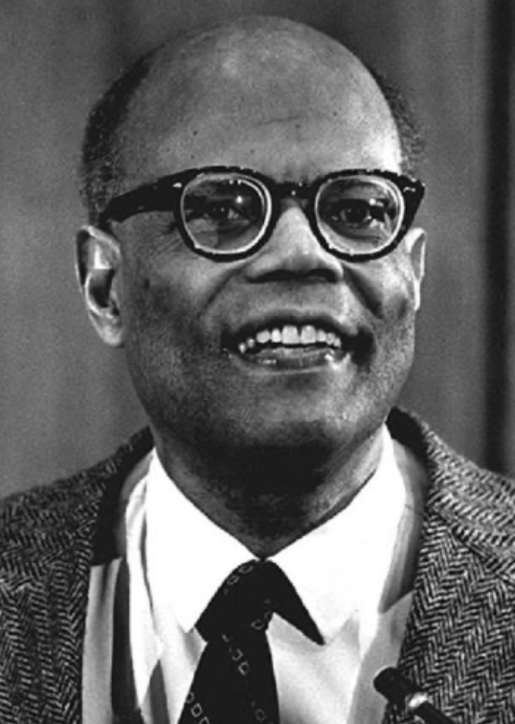
The Last Acceleration
The industrial research lab to routinize invention, and the modern corporation to routinize diffusion and deployment
Plus general purpose technologies—machine tools, non-human power sources
Arthur Lewis:
“New commodities: telephones, gramophones, typewriters, cameras, automobiles, and so on, a seemingly endless process whose latest twentieth-century additions include aeroplanes, radios, refrigerators, washing machines, television sets, and pleasure boats. Thus a rich man in 1870 did not possess anything that a rich man of 1770 had not possessed; he might have more or larger houses, more clothes, more pictures, more horses and carriages, or more furniture than say a school teacher possessed, but as likely as not his riches were displayed in the number of servants whom he employed rather than in his personal use of commodities…”
Not so much the particular technologies, as the grasping of the fact that there was a broad and deep range of new technologies to be discovered.
As much as it was new technologies, it was large-scale corporate organizations that could and did plan the division of labor to make use of and then market technologies.
And as much, it was that the global market meant that there was now a great deal of money to be made from the routinization of the exploration, development, and deployment of technological possibilities
4:15 of audio in this slide
Notes:
However, we did get that extra post-1870 innovation growth acceleration.
Around 1870 the proportional rate of growth of humanity’s technological and organizational capabilities took a further fourfold upward leap, from perhaps 0.44% per year to our current 2.1% per year or so. Thereafter technology far outran population growth. And thereafter population growth in the richest economies began to decline: humans became rich enough and long-lived enough that limiting fertility became a desirable option. Each year over 1870-1914 John Stuart Mill’s belief that the progress of science and technology, of industry and enterprise, had not lightened the day’s toil of any human being or effected great changes in human destiny became less and less true. By 1914 it had become more-or-less completely false.
1870-1914 was, in the perspective of all previous eras—as John Maynard Keynes looking back from 1919 wrote—“economic Eldorado… economic Utopia… the earlier economist would have deemed it… an unprecedented situation… an extraordinary episode in the economic progress of [hu]man[ity]”. Globally real wages of unskilled workers in 1914 look like they stood more than half again above their levels of 1870 or so—a world-wide escape from Malthus never before seen.
As Arthur Lewis put it, the net effect of the coming of a single economic world was to enable a great many countries and regions to jump on the “escalator, taking countries to ever higher levels of output per head.” Yet Lewis judges only six countries fully on the escalator of modern economic growth as of 1870.
It is understandable that China, India, and the other regions of what would become the post-World War II third world did not produce and export the relatively high-value commodities like wheat and wool exported by temperate settler economies: agricultural productivity was too low, and climate was unfavorable. It is understandable why–with heavy downward pressure put on wages in Malaysia, Kenya, and Colombia by migration and threatened migration from China and India–the prices of the export commodities that they did produce were and remained relatively low.
What is more puzzling is why industrialization did not spread much more rapidly to the future third world in the years before World War I. After all, the example of the industrial core seemed easy to follow. Inventing the technologies of the original industrial revolution–steam power, spinning mills, automatic looms, iron- and steel-making, and railroad-building–had required many independent strokes of genius. But copying the technologies did not, especially when you could buy and cheaply ship industrial capital goods made in the same New and Old England machine shops that supplied the industries of England and of America.
If Ford could redesign production so that unskilled assembly line workers do what skilled craftsmen used to do, why couldn’t Ford also—or someone else—redesign production so that it can be carried out by low wage Peruvians or Poles or Kenyans rather than by Americans, who even by 1914 were extraordinarily expensive labor by world standards?

Slide 4
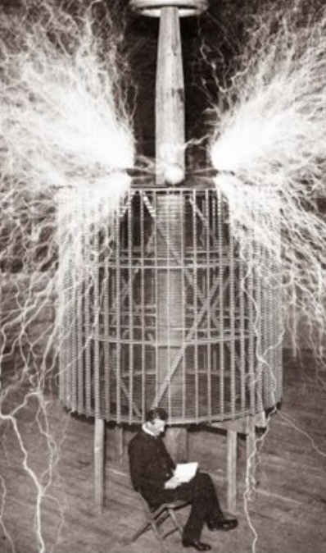
Nicola Tesla
Conventional to talk about Thomas Alva Edison; but I want to talk about Nicola Tesla
Nicola Tesla could not have had a career without the industrial research lab, the modern corporation, and George Westinghouse
Born on July 10, 1856 in the town of Smiljan, in the Krajina region of the province of Croatia, in the Habsburg empire then reigned over by the young Emperor Franz Josef in Vienna.
Fourth of five children.
His father was literate—a priest .
His mother was not.
His parents wanted him to become a priest.
He wanted to become an electrical engineer.
2:15 of audio in this slide
Notes:
What changed is that as of 1870 the leading edge North Atlantic economies had invented invention. They had not just invented textile machinery, railroads, and company. They had invented the industrial research lab, so that inventors could invent—and not have to also be development engineers, maintenance technicians, human-resource managers, bosses, cheerleaders, marketers, impresarios, and financiers. They had invented bureaucracy, in the form of the large corporation, so that what was invented in the industrial research labs could then be deployed at national or continental scale. And they had invented the idea that there was a great deal of money to be made and satisfaction to be earned by inventing not just better ways of making old but making brand-new things.
It is traditional at this point in any history to talk about Thomas Alva Edison. The most famous inventor in the world, "the wizard of Menlo Park," New Jersey, registered more than 1000 patents and founded 15 companies—including what is now called General Electric. But that story is too well-known.
Let’s talk about another migrant who, like Herbert Hoover, moved west—but not from Iowa to Oregon and California to Australia and China to London. Let’s talk about someone who moved from Croatia to America. And let’s talk about someone who ended up not a multimillionaire ex-president and respected Republican elder. Let’s talk about somebody who ended up a penniless charity case, living in midtown Manhattan without any roof of his own.
Let’s talk about Nicola Tesla.
Nikola Tesla, born on July 10, 1856 in the town of Smiljan, in the Krajina region of the province of Croatia, in the Habsburg empire then reigned over by the young Emperor Franz Josef in Vienna. He was the fourth of five children. His father was literate—a priest in the Serbian Orthodox Church—but his mother was not. His parents wanted him to become a priest. He wanted to become an electrical engineer.

Slide 5
Nicola Tesla II
Went off to Graz, Austria, to go to college. Dropped out after two years.
Broke off relations with his family and friends
Worked as an engineer for two years
Suffered a “nervous breakdown”.
His father persuaded him to return to college at Prague’s Karl-Ferdinand University.
Perhaps he did.
But if so only for one summer.
And then his father died.
1881 finds Nikola Tesla working in Budapest for a startup, the National Telephone Company of Hungary, as chief electrician and chief engineer. But he does not stay.
1882 sees him in Paris working as an improver and adapter of American technology.
On June 6, 1884 Tesla arrived in New York with nothing in his pockets save a letter of recommendation from engineer Charles Batchelor to Thomas Edison: “I know of two great men,” Batchelor had written. “You are one of them. This young man is the other.” And so Edison hired Tesla.
1:00 of audio in this slide
Notes:
He studied electrical engineering in Graz, Austria. He dropped out after two years, broke off relations with his family and friends, worked as an engineer for two years, and apparently suffered a nervous breakdown. His father persuaded him to return to college at Prague’s Karl-Ferdinand University. Perhaps he did, but if so only for one summer. And then his father died.
1881 finds Nikola Tesla working in Budapest for a startup, the National Telephone Company of Hungary, as chief electrician and chief engineer. But he does not stay. 1882 sees him in Paris working as an improver and adapter of American technology. And on June 6, 1884 Tesla arrived in New York with nothing in his pockets save a letter of recommendation from engineer Charles Batchelor to Thomas Edison: “I know of two great men,” Batchelor had written. “You are one of them. This young man is the other.” And so Edison hired Tesla.

Slide 6

Nicola Tesla III
Tesla had an “eccentric personality,” as people put it. He wrote:
“I had a violent aversion against the earrings of women... bracelets pleased me more or less according to design. The sight of a pearl would almost give me a fit but I was fascinated with the glitter of crystals... I would get a fever by looking at a peach... I counted the steps in my walks and calculated the cubical contents of soup plates, coffee cups and pieces of food—otherwise my meal was unenjoyable. All repeated acts or operations I performed had to be divisible by three and if I missed I felt impelled to do it all over again, even if it took hours…"
To medicalize: autism/OCD. But is “medicalization” really something we want to do?
This, coupled with bizarre and utopian claims about the future course of science and technology, made it difficult for him to find and maintain financial backers and colleagues.
He was, as much as Mary Wollstonecraft Shelley’s fictional Dr. Viktor von Frankenstein, the very model of the lone mad scientist.
Yet George Westinghouse found a place for him:
Our entire electrical power grid and everything that draws off of it
Our electric appliances and engines today
Alternating-current generators, polyphase systems, and long-distance transmission through high-voltage power lines,
The world from space at night, illuminated by the electric power grid, is Tesla’s world.
1:30 of audio in this slide
Notes:
In America Tesla went to work for Edison Machine Works. He would later claim that Edison promised him $50,000—the entire net worth at the time of the Edison Machine Works, the same multiple of average wages back then that $7 million would be today, and the same share of GDP back then that $40 million would be today—to improve and redesign Edison’s direct current generators, but that in 1885 Edison refused to pay. Tesla quit and found himself digging ditches for a living for a couple of years.
Our entire electrical power grid and everything that draws off of it, our electric appliances and engines today, based as they are on alternating-current generators, polyphase systems and long-distance transmission through high-voltage power lines, are Tesla’s much more than they are Thomas Edison’s. The world from space at night, illuminated by the electric power grid, is Tesla’s world.
Tesla and his allies beat Thomas Edison and his in the struggle over whether electricity was going to be AC or DC. And his was the first, or at least one of the first, demonstrations of radio in 1894, which was at the time regarded as a great mystery. It was Albert Einstein who, when asked to explain radio, said:
>You see, a wire telegraph is a kind of a very, very long cat. You pull his tail in New York and his head is meowing in Los Angeles. Do you understand this? And radio operates exactly the same way: you send signals here, they receive them there. The only difference is that there is no cat…

Slide 7
Nicola Tesla IV
How could Tesla make a difference?
He made a difference because he could work for corporations
And his ideas could be developed and applied by corporations.
In America Tesla went to work for Edison Machine Works. He would later claim that Edison promised him $50,000—the entire net worth at the time of the Edison Machine Works, the same multiple of average wages back then that $7 million would be today, and the same share of GDP back then that $40 million would be today—to improve and redesign Edison’s direct current generators, but that in 1885 Edison refused to pay.
Tesla quit
Tesla found himself digging ditches for a living for a couple of years
Tesla on Edison’s death: Edison “had no hobby, cared for no sort of amusement of any kind and lived in utter disregard of the most elementary rules of hygiene .... His method was inefficient in the extreme, for an immense ground had to be covered to get anything at all unless blind chance intervened and, at first, I was almost a sorry witness of his doings, knowing that just a little theory and calculation would have saved him 90 percent of the labor. But he had a veritable contempt for book learning and mathematical knowledge, trusting himself entirely to his inventor's instinct and practical American sense...”
2:00 of audio in this slide
Notes:
How could Tesla make a difference? He made a difference because he could work in industrial research labs for corporations, and his ideas could be developed and applied by corporations. He could work for George Westinghouse. And General Electric could copy what he had done.
Tesla made inventions. 1887 saw Tesla as the proprietor of Tesla Electric Light and Manufacturing (but his financial backers soon fire him from his own company). 1888 saw Tesla demonstrating an alternating-current induction motor—the ancestor of all our current alternating-current motors—at the American Institute of Electrical Engineers meeting.
Tesla found a permanent financial backer. 1889 saw Tesla working at the Westinghouse Electric and Manufacturing Company’s laboratory in Pittsburg. In 1891, at the age of 35, Tesla was back in New York establishing his own laboratory. In 1892 he became vice president of the American Institute of Electrical Engineers and received his patents for the polyphase alternating-current electric power system. And in 1893 Nikola Tesla and George Westinghouse used alternating-current power to illuminate the Chicago’s World Fair—the first World Fair ever to have a building for electricity and its applications.
The late 1880s and 1890s saw Westinghouse and Tesla and their backers struggle against Edison and his backers in the so-called “war of the currents.” Thomas Alva Edison had bet on a direct current—DC—electrical grid. Direct current worked very well with incandescent lamps and with the motors of the day. Direct current fit well with storage batteries, which meant that you only had to build the expensive generating capacity for average loads rather than peak loads. And Edison had not understood what Tesla was getting at when Tesla started ranting and raving about alternating current possibilities.

Slide 8
Nicola Tesla VI
Then the financial backers pull the plug:
Dominant financier J.P. Morgan backed Tesla, directly and indirectly, for a long while.
But then in 1907 Morgan decided that the heroic age of electricity was over
Time to rationalize operations
Time to replace the visionary inventors like Tesla and the executives like George Westinghouse who would cater to them.
Time for managers who would routinize the business, and focus on the bottom line.
1:15 of audio in this slide
Notes:
Dominant financier J.P. Morgan backed Tesla, directly and indirectly, for a long while. But then in 1907 he decided that the heroic age of electricity was over, and it was time to rationalize operations and replace the visionary inventors like Tesla and the executives like George Westinghouse who could deal with them by managers who would routinize the business, and focus on the bottom line.
Tesla died during World War II, penniless, a charity case protected from the world by the grace of the management of the Waldorf-Astoria hotel. During World War II the U.S. Supreme Court decided that Tesla owned the radio patents, perhaps because the then-penniless Tesla was less likely to make trouble if he owned the radio patents than if Marconi’s heirs did.
Tesla then could not get it together to try to get any money from his radio patents, and he soon died. After he died the FBI tore apart his hotel room, because he claimed he had invented and had a working model of a death ray.

Slide 9
Catch Our Breath…
Ask a couple of questions?
Make a couple of comments?
Any more readings to recommend?
<>

